Slide 1
CNS development
Brain and spinal cord

Slide 2
CNS appears at the beginning of 3rd week. It’s a slipper shape thickened ectoderm. Known as neural plate. Located in mid dorsal region in front of the primitive pit.
Lateral edge elevates – neural folds.
Neural folds fuse in the midline – neural tube.Fusion begins in the cervical region(final closure on 25th day.) Fusion progress in cephalo caudal region. Closure of caudal end occurs 2days later.
Cephalic end has 3 dilatations : procencephalon (fore brain) mesencephalon (mid brain) and rhombencephalon (hind brain).
Simultaneously two flexures – cervical (hind brain and spinal cord) and cephalic (midbrain region).

Slide 3
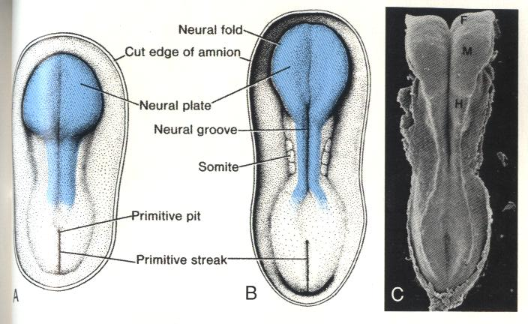

Slide 4
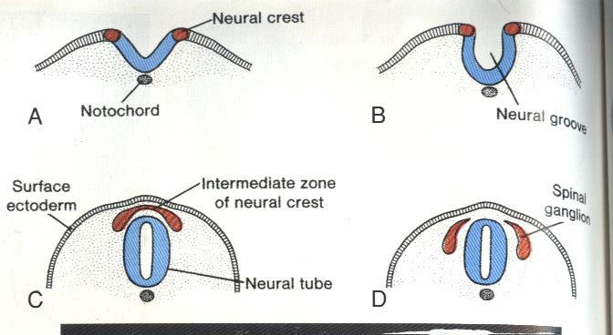

Slide 5
Procencephalon – telencephalon and diencephalon. Telencephalon – two cerebral hemispheres and mid portion.
Mesencephalon is separated by rhombencephalon by a deep furrow.
Rhombencephalon- metencephalon and myelencephalon. Boundary is pontine flexure.
Metancephalon – pons and cerebellum.
Myelencephalon- medulla.
Spinal cord – central canal, diencephalon – 3rd ventricle, rhombencephalon – 4th ventricle, cerebral hemispheres – lateral ventricle.

Slide 6
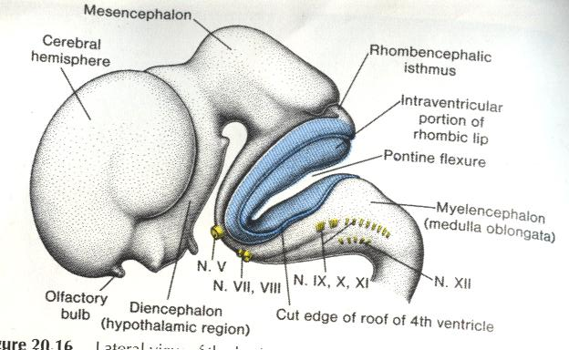

Slide 7
Cavity of 3rd and 4th are connected by cavity of mesencephalon (aqueduct of sylvius).
Lateral ventricles and 3rd ventricle are connected by foramina of Monro.
Spinal cord- wall of neural tube consists of neuroepithelial cells.They divide rapidly and produce more cells – neuro epithelium.
Neuro epithelium – neuro blasts – mantle layer (surrounds the neuroepithelium). Becomes the gray matter of spinal cord.
Outside mantle layer is the marginal layer. Has nerve fibres emerging from the mantle layer.Nerve fibres undergo myalination – white matter of spinal cord.

Slide 8
Basal and alar plates-
Continuous addition of neuroblasts to mantle layer – ventral(basal) and dorsal(alar) thickenings. Basal plates has motor horn cells. Forms – motor area. Alar plates form the sensory area.
Between ventral horns and dorsal horns group of neurons accumilate and form – intermediate horn. Contains neurons of sympathetic system. Present in thoracic and upper lumbar levels.

Slide 9
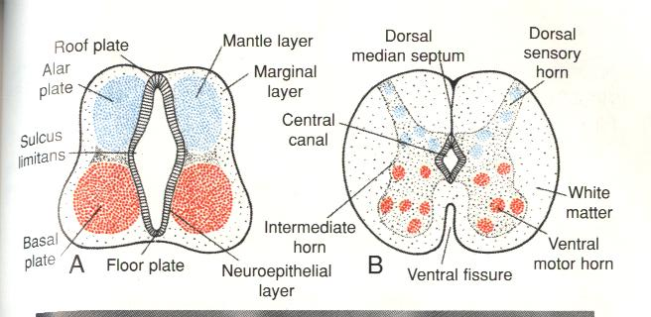

Slide 10
Positional changes of the cord –
3rd month of deve – entire length of embryo.
At birth – 3rd lumbar vertebra.
Adult – 1st lumbar vertebra.
Thread like extension of piamater – C1 body.
Due to the disproportionate growth spinal nerves run obliquely from their origin at spinal cord to corresponding level of vertebral column.

Slide 11
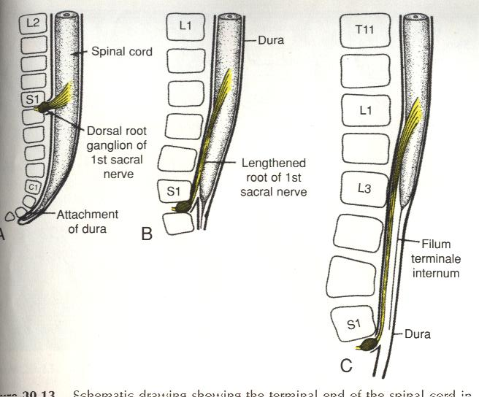

Slide 12
Spinal nerves – motor nerves appear around 4th week of development from cells of ventral horns. These nerves collect into bundles – ventral nerve roots. Dorsal roots arise as a collection of fibres originating from cells in dorsal root ganglia.
Neuroepithelial cells – neuroblasts and glial cells.
Neural crest cells – schwann cells. Neural crest cells are cells at the each edge of neural groove.

Slide 13
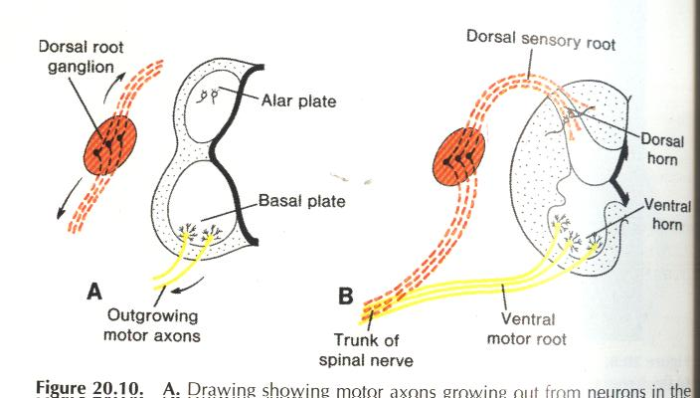

Slide 14
Cranial nerves:
By 4th week all 12 cranial nerve nuclei are present.
Except olfactory and optic all arise from the brain stem. Occulomotor arises outside the hind brain.
Neuro epithelium of hind brain – 8 pairs of rhombosomes. Give rise to motor nuclei of cranial nerves – 5,6,7,8,9,10,11 and 12.
Motor cranial nuclei are located within the brainstem. Sensory ganglia located outside the brain.

Slide 15
Autonomic nervous system-
Sympathetics – located in the thoraco lumbar region. Arises in the 5th week. Cells originate from neural crest cells of thoracic region. These cells migrate on each side of spinal cord to a region immediately behind the dorsal aorta. These form a bilateral chain of segmentally arranged sympathetic ganglia.
Preganglionic fibres arise from intermediate horn of thoraco lumbar segment. Has a myelin sheath. Post ganglionic fibres are axons of sympathetic ganglion cells. No myelin sheath.

Slide 16
Parasympathetic nervous system-
Preganglionic fibres arise from neurons in brainstem and sacral regions of spinal cord.
Ganglia arise from neural crest cells.
Post ganglionic fibres arise from neurons of ganglion cells.
Clinical correlates –
Ossification defects of skull bones following things occur.
Meningocele- only meningies. Meningo encephalocele – meningies + part of brain.
Meningo hydroencephalocele- meningies + part of brain + ventricles.

Slide 17
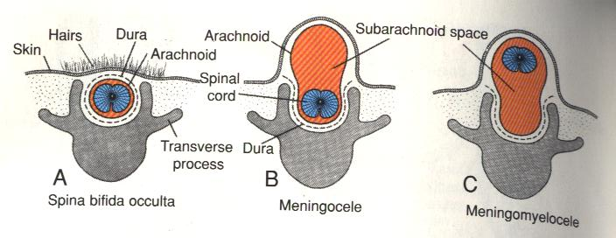

Slide 18
Anencephaly – failure of cephalic part of neural tube to close – vault of skull does not form – malformed brain exposed – brain tissue degenerates. Common in females.
Microcephaly – cranial vault is smaller than normal. Defect is in the brain development. Can occur due to AR disorders, maternal infections,teratogens. Mental retardation present.
Hydrocephalus – abnormal accumilation of CSF in the ventricles due to aqueduct stenosis.
Arnold-chiari malformation – caudal displacement of cerebella structures through the foramen magnum. Hydrocephalus present.

